Slide 1
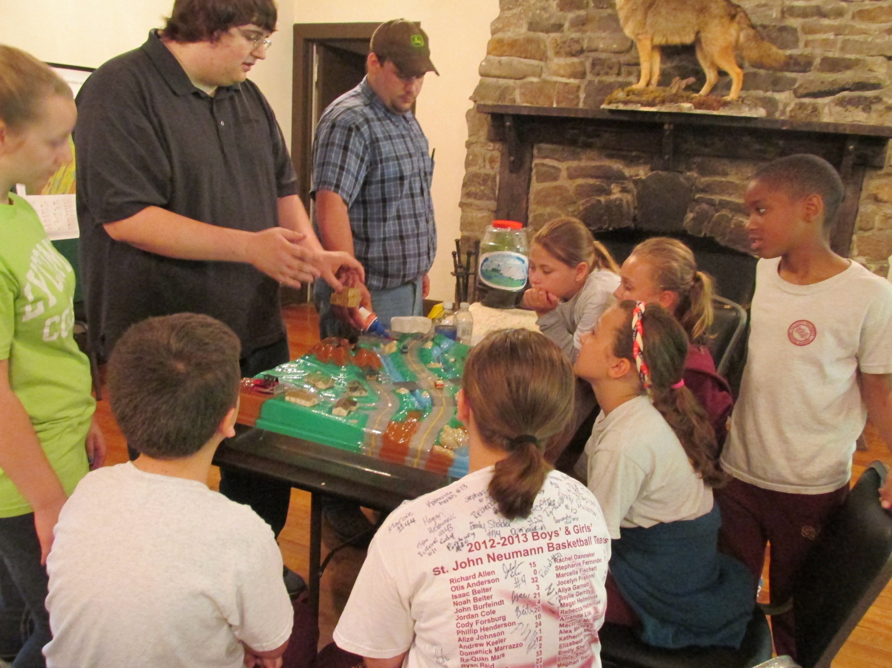
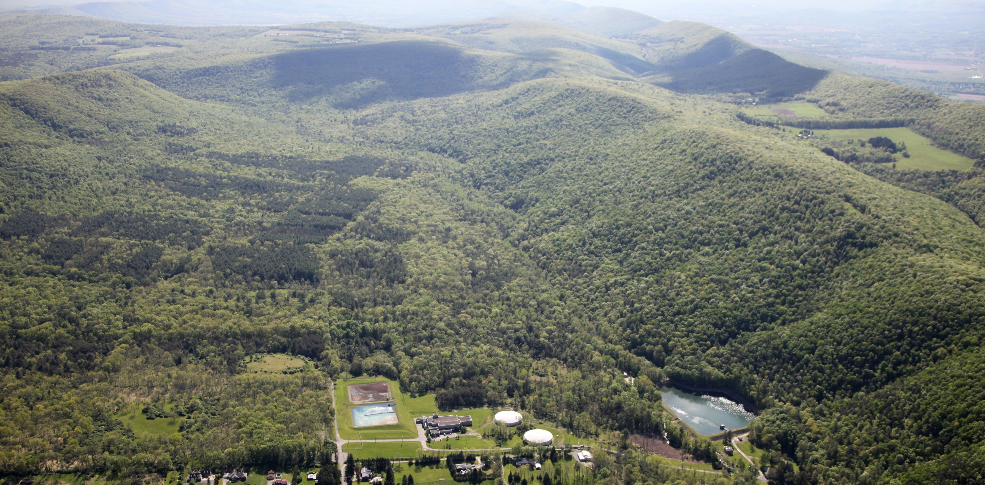
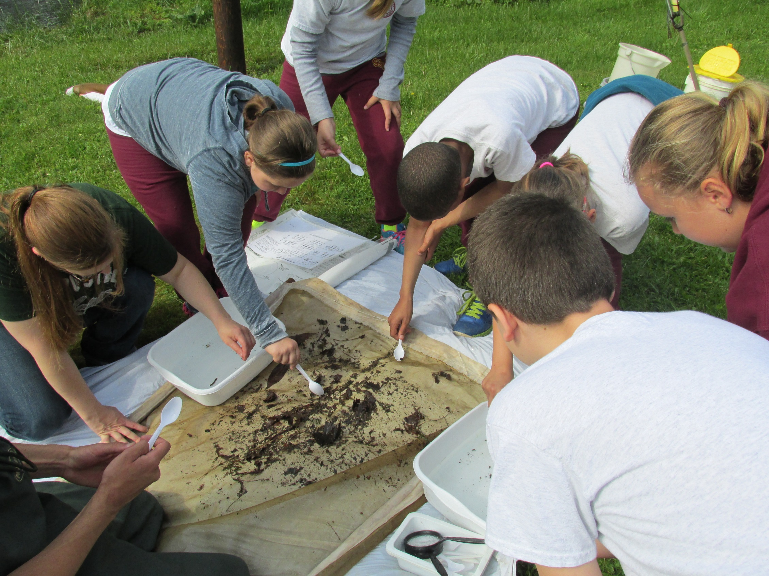
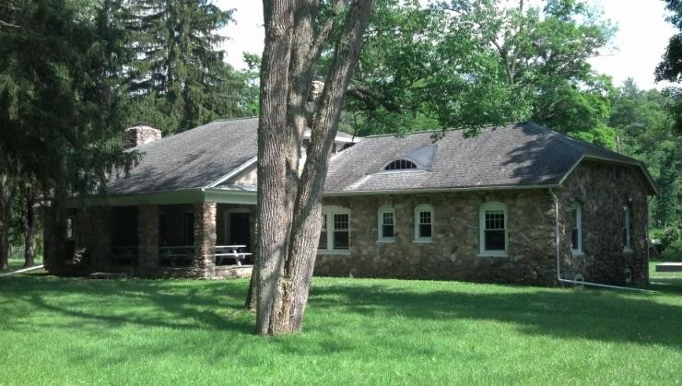
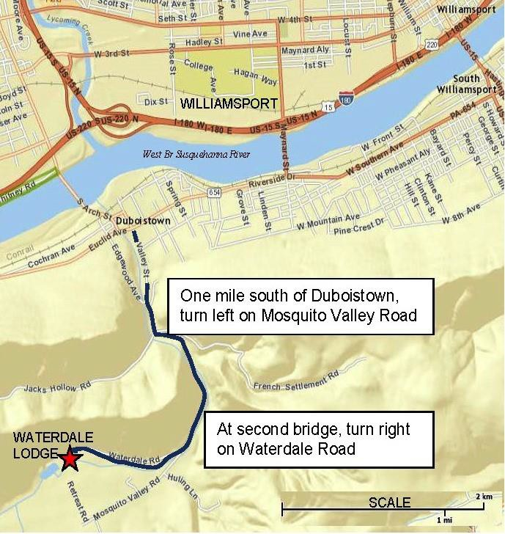
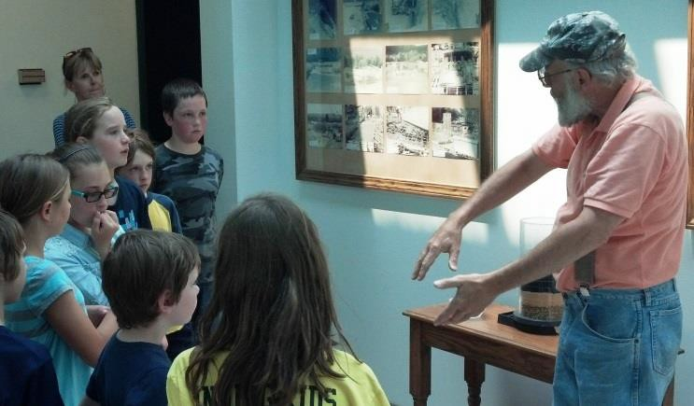
Community Partnership of the Waterdale Environmental Education Center Justin Potuck, Supervisor: Dr. Mel Zimmerman
Overview: Located in the valley of the Mosquito Creek Watershed and adjacent to the Williamsport Municipal Water Authority Filtration Plant, is the historic Waterdale Lodge. Starting in 2014, a group of partners that includes Lycoming College (Clean Water Institute and Departments of Biology and Education), Williamsport Water Authority, and the Lycoming County Conservation District formed the Waterdale Environmental Education Center as a resource for K-12 education outreach as well as a venue for college research projects and community events. Educational programs at Waterdale include development of nature trail walks, aquatic macro invertebrate and fish sampling and identification, water filtration plant tour, water monitoring and testing, and live demonstrations of an Enviroscape watershed model. Several full or partial day field trips for local elementary schools have been scheduled, including hands-on indoor and outdoor activities. Documentation of efforts to develop programs to educate the public on the importance of source water protection of drinking water supplies will be presented. In addition, water quality data from our monitoring effort will be presented.
Figure 4: Aerial view of the Williamsport Municipal Water Authority Filtration Plant and Waterdale Lodge
Justin Potuck
Lycoming College CWI, 2014
Our mission: The goals of the Waterdale
Environmental Education Center include:
Increasing public awareness about source water protection
Provide a venue for scientific field work, teaching experiences, and a real world environmental setting for local resource and academic professionals
Work with Project WILD and Project WET to provide training for upcoming educators
Share information on water resource management and protections of public water supply sources.
Figure 1: Outside historic Waterdale Lodge
Figure 5: Students from St. John Neumann sort through leaf packs for aquatic macro-invertebrates
Parameters | Site 1 | Site 2 | Site 3
pH (Lab) | 7.43 | 7.33 | 7.33
Conductivity (µS) | 121.1 | 124 | 122.3
Alkalinity (ppm) | 13 | 31 | 45
Orthophosphate (ppm) | 0.12 | 0.09 | 0.09
Phosphorous (ppm) | 0.15 | 0.12 | 0.15
Nitrate (ppm) | 0.9 | 1.3 | 0.4
Nitrite (ppm) | 0.004 | 0.004 | 0.005
DO (ppm) | 17.95 | 16.1 | 14.72
Temp (°C) | 1.1 | 1.2 | 1.1
TDS (ppm) | 60.9 | 61.4 | 61.3
Figure 3: Sample of Water Chemistry Data Monitoring from Mosquito Creek, located adjacent to the Waterdale Lodge 1/20/15
Figure 6: Larry Bennett, Williamsport Municipal Water Authority, shows local students how drinking water is treated
Acknowledgements:
Lycoming College Clean Water Institute
Lycoming College Education Department: Dr. Amy Rogers
Williamsport Municipal Water Authority:
Walt Nicholson – Larry Bennett
Lycoming Count Conservation District: Carey Entz-Rine
Figure 2: Overhead map showing route to Waterdale Lodge from Duboistown

